Slide 1
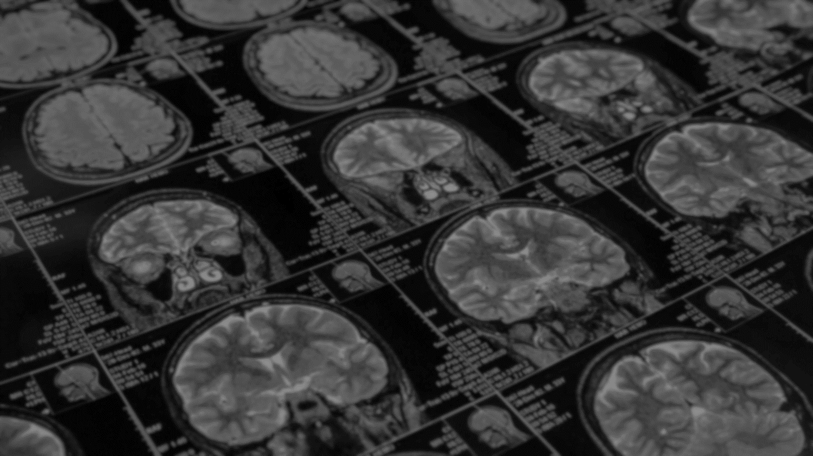

2
+
ALZHEIMER’s Diagnosis A Deep Learning CNN based approach for detecting Alzheimer’s Disease using Brain MRI Scans
2
+
NAME
DEPT
SEM
USN
1

Slide 2
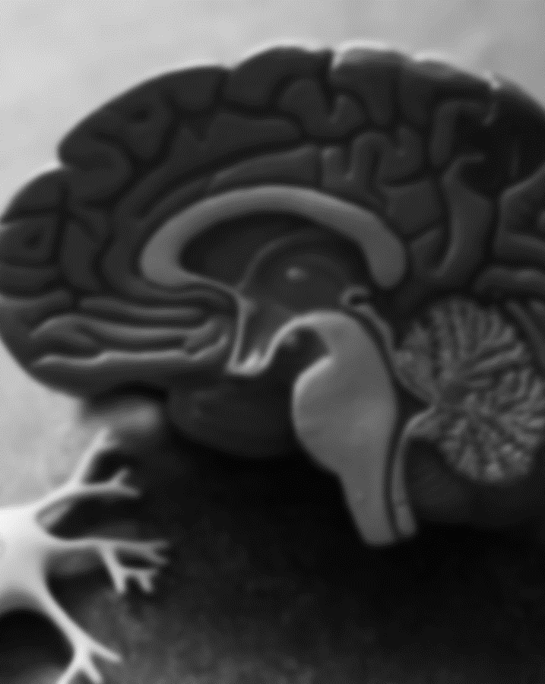
Alzheimer’s disease
2
+
Alzheimer’s disease is a brain disorder that slowly destroys memory and thinking skills and, eventually, the ability to carry out the simplest tasks. In most people with the disease — those with the late-onset type symptoms first appear in their mid-60s. Early-onset Alzheimer’s occurs between a person’s 30s and mid-60s and is very rare. Alzheimer’s disease is the most common cause of dementia among older adults.
The damage initially takes place in parts of the brain involved in memory, including the entorhinal cortex and hippocampus. It later affects areas in the cerebral cortex, such as those responsible for language, reasoning, and social behavior. Eventually, many other areas of the brain are damaged.

Slide 3
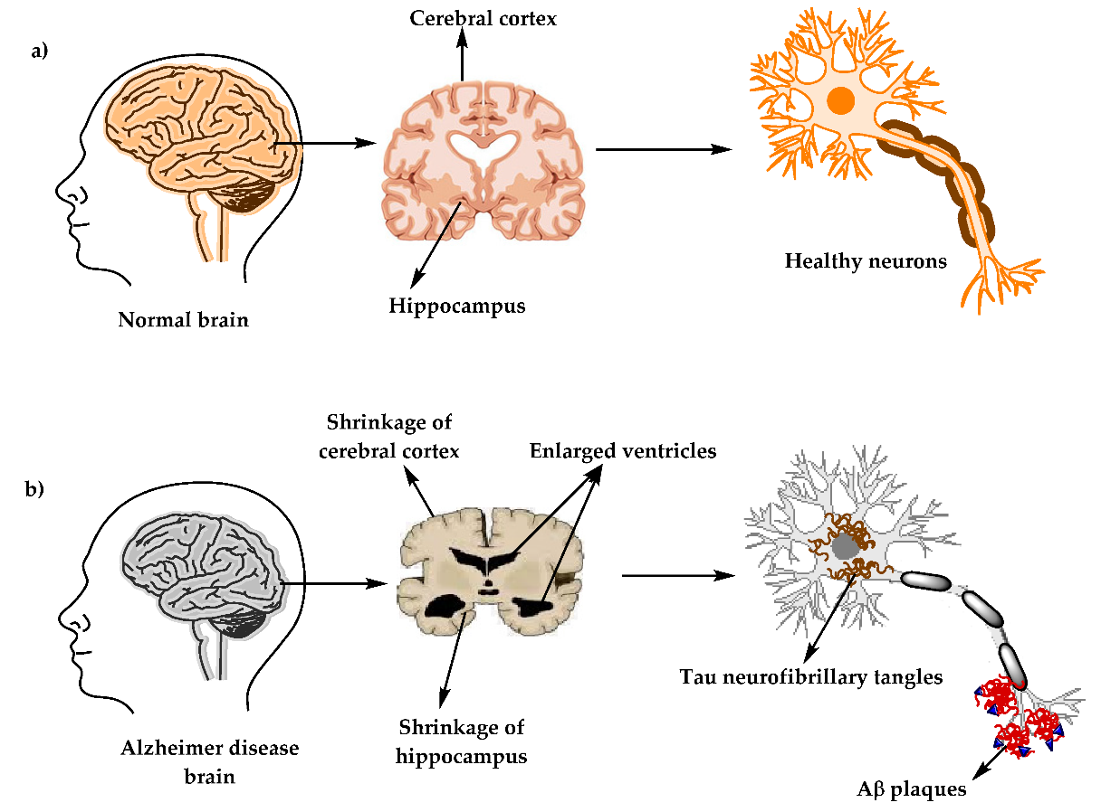
An Alzheimer’s affected brain

Slide 4
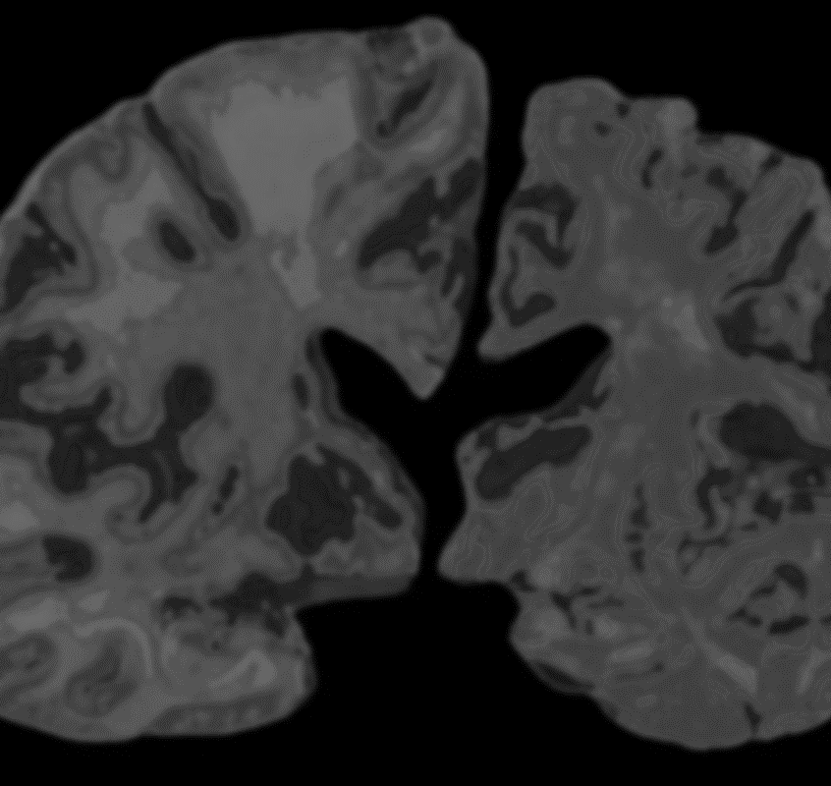
Magnetic resonance imaging
2
+
AND MEDICAL IMAGING TECHNIQUES
Magnetic resonance imaging (MRI) is a medical imaging technique that uses a magnetic field and computer-generated radio waves to create detailed images of the organs and tissues in your body.
Most MRI machines are large, tube-shaped magnets. When you lie inside an MRI machine, the magnetic field temporarily realigns water molecules in your body. Radio waves cause these aligned atoms to produce faint signals, which are used to create cross-sectional MRI images — like slices in a loaf of bread.
A functional MRI of the brain (fMRI) produces images of blood flow to certain areas of the brain and can be used to assess damage from a head injury or from disorders such as Alzheimer's disease.

Slide 5
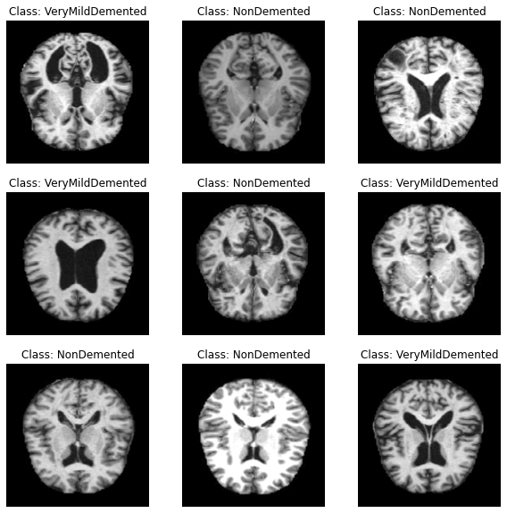
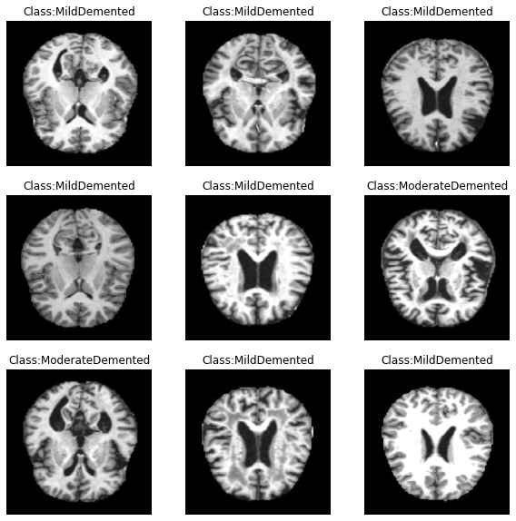
Functional mri (fmri) samples

Slide 6
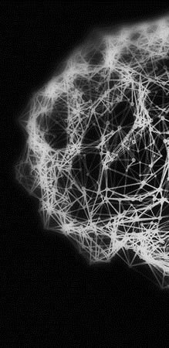
PROJECT ABSTRACT
PROJECT MODULES
The pipeline of the project includes three components:
Dataset – Alzheimer Preprocessed MRI
Data Acquiring and Preprocessing [Python modules Used: ImageDataGenerator (TensorFlow), SMOTE (Imbalanced-Learn)]
Model Training and Evaluation [Python modules Used: TensorFlow, OpenCV, Scikit-Learn, NumPy,Joblib,Keras,Pandas,Matplotlib]
Web Application [Technologies Used: Flask (Python),Streamlit (Python), HTML, CSS, Bootstrap, JavaScript]
This project is an implementation of an Alzheimer’s Diagnosis System. This means that upon being provided the MRI of the patient’s Brain, the presence and stage/type of Alzheimer’s can be accurately detected.
This is done using a Deep Learning model that utilizes the power of Convolutional Neural Networks (CNNs).
When validated over 4 classes of Image data, the model gave an accuracy of 98.88%.

Slide 7
Deep Learning
CNN
Deep learning is a subset of machine learning, which is essentially a neural network with three or more layers. These neural networks attempt to simulate the behavior of the human brain—albeit far from matching its ability—allowing it to “learn” from large amounts of data.
A Convolutional Neural Network (CNN) is a type of Deep Learning neural network architecture commonly used in Computer Vision. Computer vision is a field of Artificial Intelligence that enables a computer to understand and interpret the image or visual data.
When it comes to Machine Learning, Artificial Neural Networks perform well. Neural Networks are used in various datasets like images, audio, and text. Different types of Neural Networks are used for different purposes, for example for predicting the sequence of words we use Recurrent Neural Networks more precisely an LSTM, similarly for image classification we use Convolution Neural networks. In this blog, we are going to build a basic building block for CNN.

Slide 8
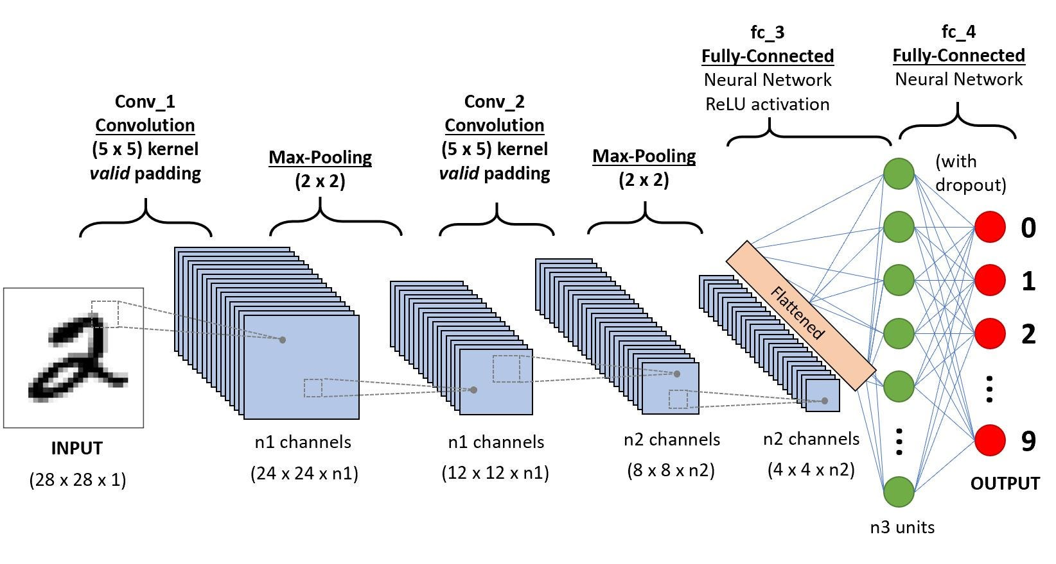
CNN Model

Slide 9
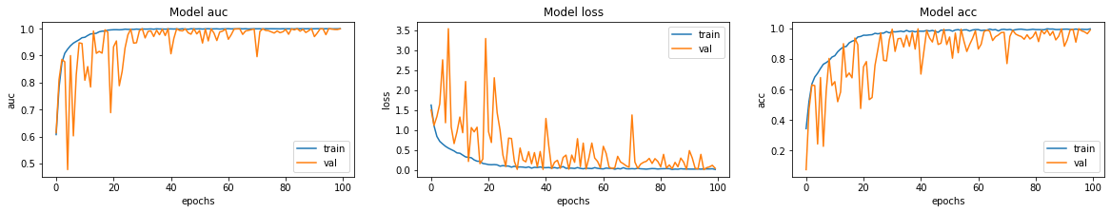
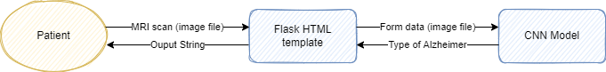
APPLICATION WORKFLOW
Model Metrics

Slide 10
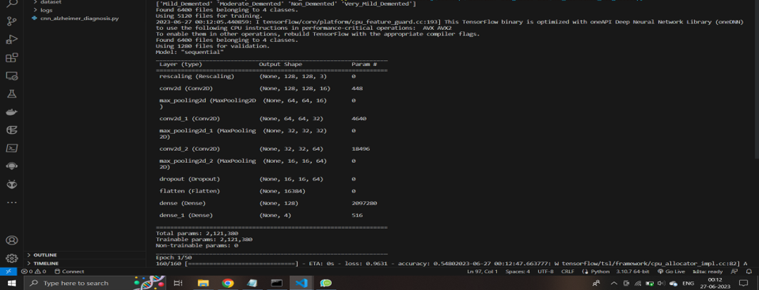
CNN Model Summary

Slide 11
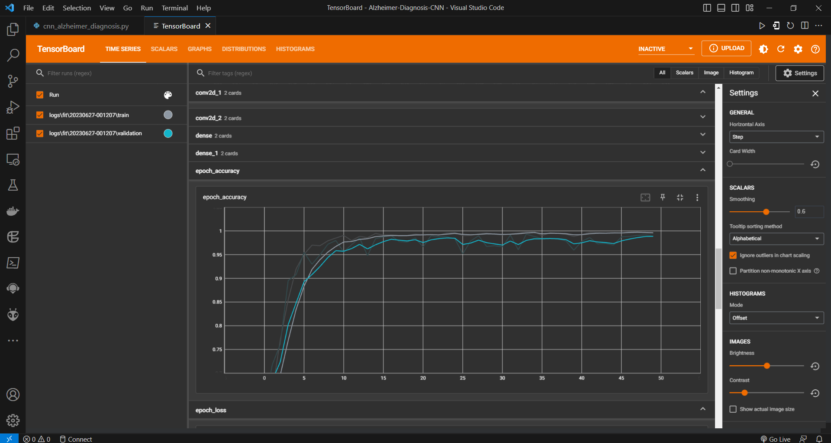
Model Accuracy – 0.9955

Slide 12
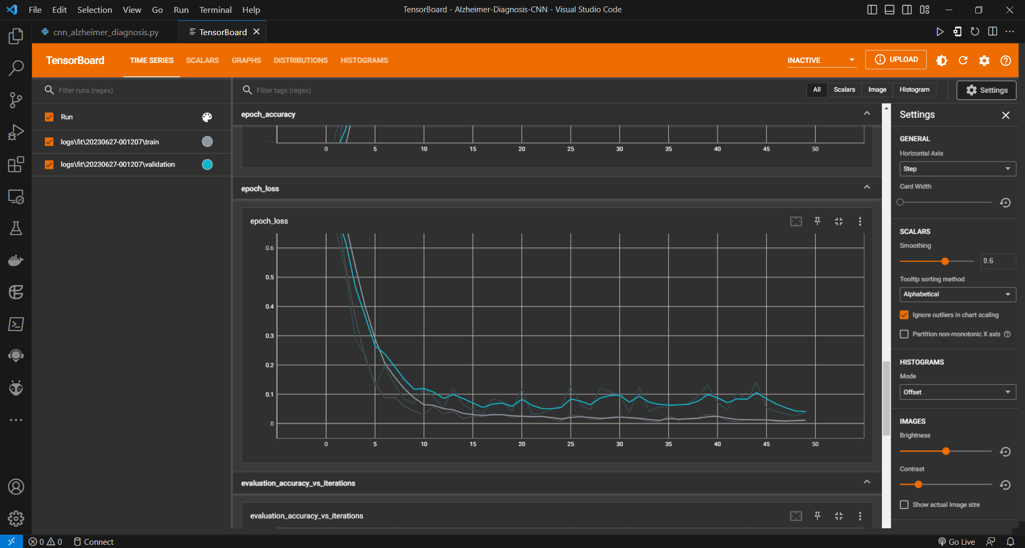
Model Loss with Epochs and Iterations

Slide 13
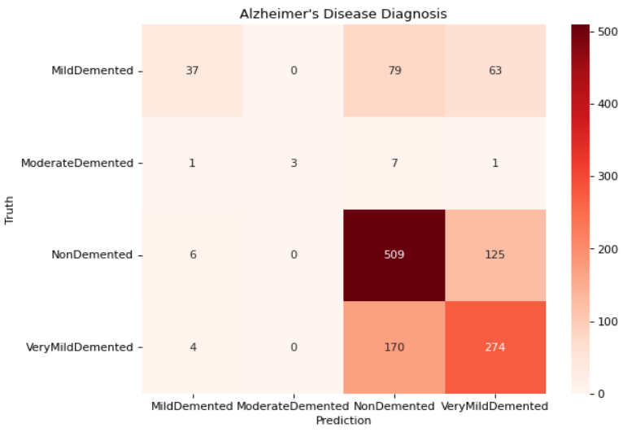
Model – Confusion Matrix

Slide 14
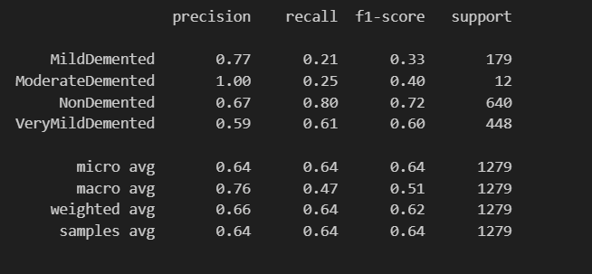
Model – Classification Report

Slide 15
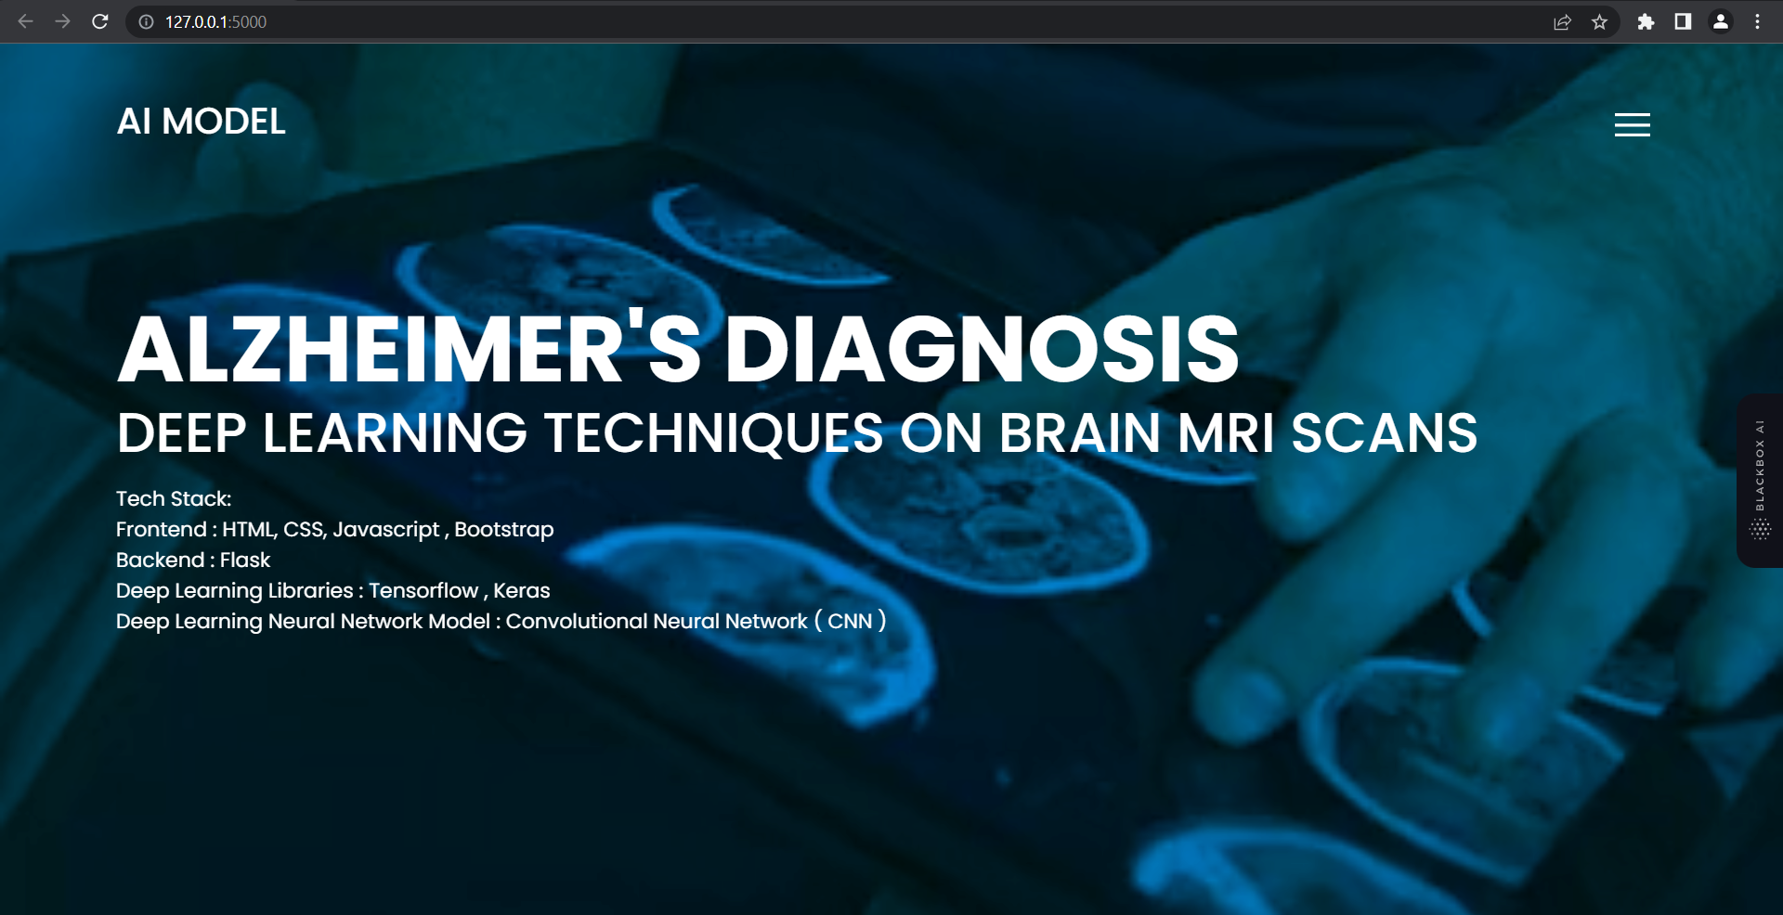
Flask – Web Application

Slide 16
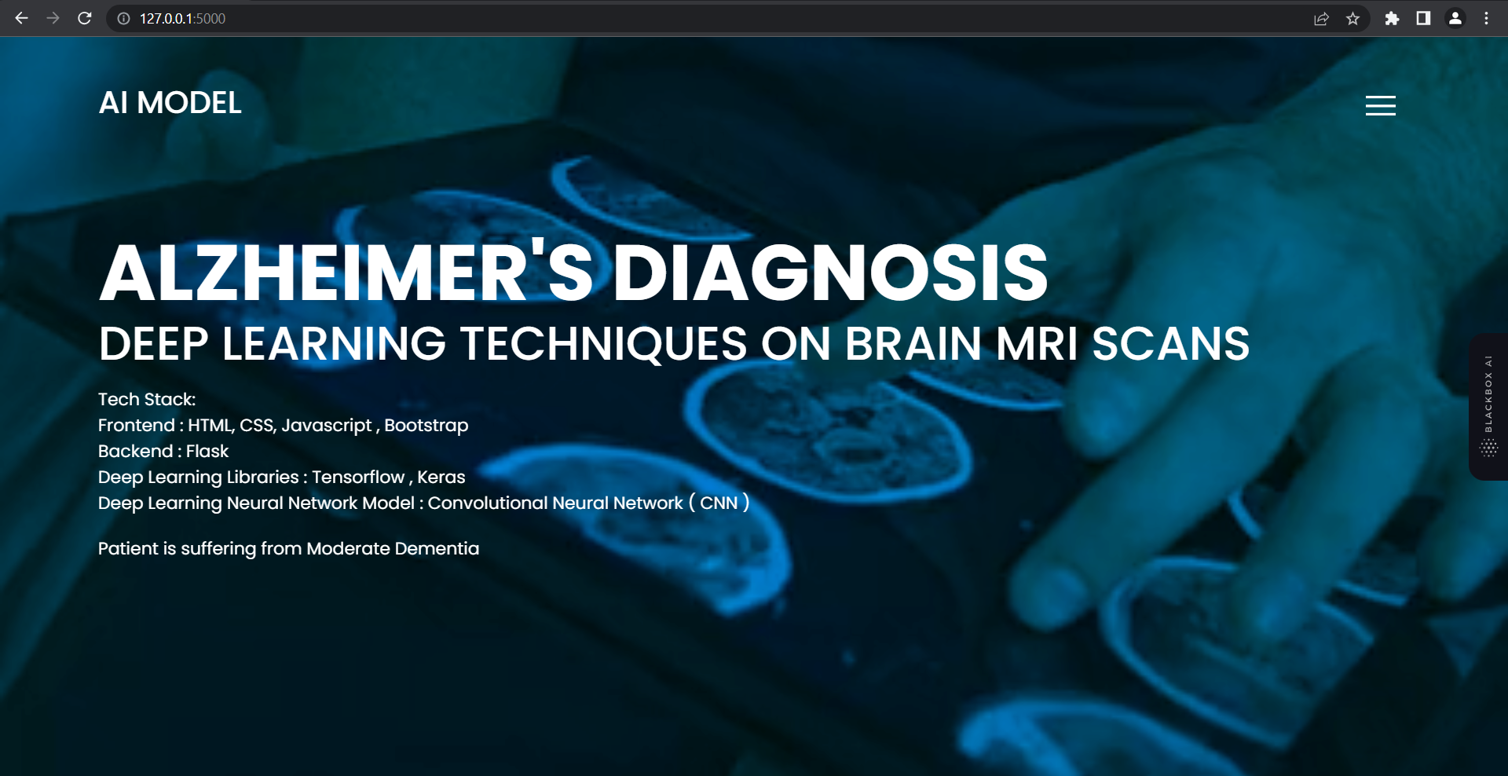
Flask – Web app prediction

Slide 17
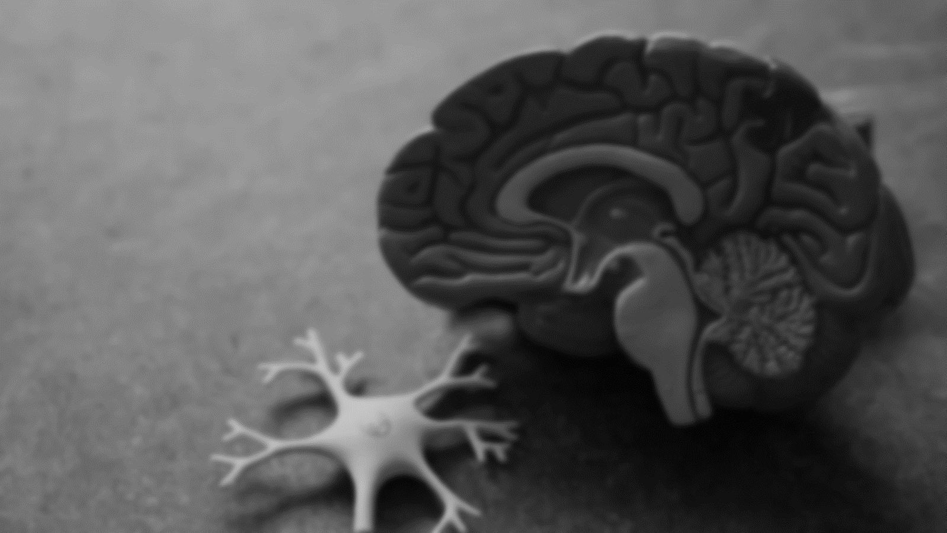
THANK YOU
2
+

